Slide 1




SMART INDIA HACKATHON 2026
TITLE PAGE
  Problem Statement ID - 26166
  Problem Statement Title - Multi-modal, Sun angle and scale invariant image correspondence using Chandrayaan-2 optical images (OHRC, TMC and IIRS)
  Theme - Space Technology
  PS Category- Software
  Team ID - (not allotted till now)
  Team Name (Registered on portal) - Shevolution

Slide 2


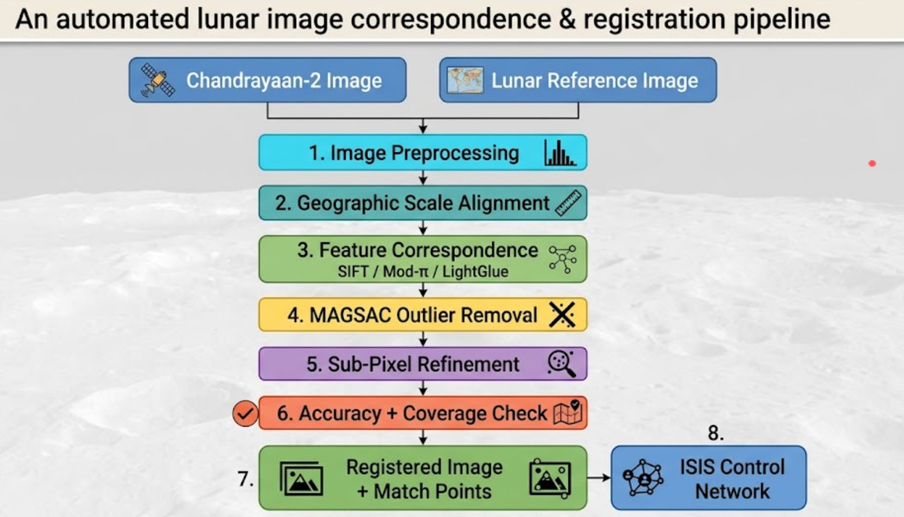

LUNARMATCH
Illumination-Robust Lunar Image Registration
Shevolution
PROBLEM EXISTING
PROPOSED SOLUTION
Same lunar region ≠ same appearance
Matching Chandrayaan-2 images with lunar reference images is difficult because the same surface can appear very different due to:
  Illumination Variation
Different Sun azimuth/elevation changes shadows and surface brightness, making corresponding features difficult to identify.
  Viewpoint Variation
Different camera positions and orientations cause shifts, rotation, scaling and perspective distortions.
  Scale Variation
Different missions operate at different altitudes and resolutions, creating a large scale difference between images.
Manual identification of matching points is time-consuming, while conventional automated matching can fail under illumination, viewpoint and scale variations.
UVP - UNIQUE VALUE PROPOSITION
  Unique Sun-Angle Simulator - simulate different Sun azimuth & elevation conditions on the same lunar terrain.
  Edge/Gradient-Based Matching - reduce the effect of illumination and shadow changes.
  Automatic Scale Alignment - bring Chandrayaan-2 and LRO images to a common scale before matching.
  Reliable Match Verification - use MAGSAC to remove incorrect matches.
  Uniform Match Distribution - ensure matches are spread across the image, not clustered in one area.
  Sub-Pixel Accuracy - refine matched points for precise registration.
  ISRO/ISIS-Compatible Output - export verified tie points as an ISIS control network.
LunarMatch takes a Chandrayaan-2 image and a lunar reference image, preprocesses them to reduce illumination effects, aligns them to a common scale using geographic information, and finds corresponding features using SIFT, Mod-π, or LightGlue. MAGSAC removes incorrect matches, sub-pixel refinement improves accuracy, and RMSE, inlier count, and coverage validate the result. Finally, the registered image and verified match points are exported as an ISIS Control Network for downstream photogrammetry.
@SIH Idea submission- Template
2

Slide 3
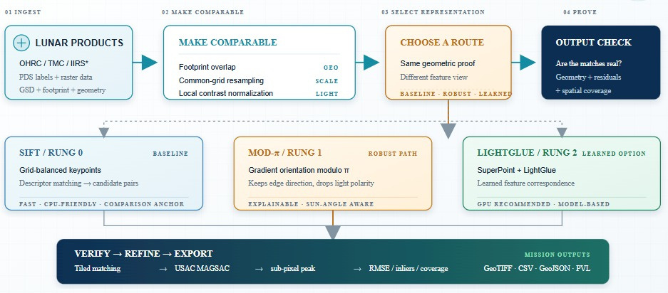

TECHNICAL APPROACH
Shevolution
TECH STACK
Python · OpenCV · NumPy · SciPy · Shapely (footprint geometry) · PyTorch + LightGlue / SuperPoint · MAGSAC . rasterio (GeoTIFF I/O, GDAL-optional) · FastAPI . React . Tailwind CSS . SQLite . Three.js · pytest - 188 tests, all hand-checkable against synthetic ground truth
@SIH Idea submission- Template
3

Slide 4
FEASIBILITY AND VIABILITY
Shevolution
FEASIBILITY
VIABILITY
  Technically Feasible: Our pipeline has been tested using synthetic data with known answers, and the automated test suite is passing.
  Real Data Support: The system is designed to read Chandrayaan-2 and LRO image formats and convert them into a common format.
  End-to-End Pipeline: The system performs preprocessing, scale alignment, feature matching, incorrect-match removal and accuracy evaluation.
  Open-Source: Built using open-source computer vision and scientific computing tools, reducing software cost.
  Scalable: Large lunar images can be divided into smaller tiles so they can be processed efficiently.
  Reduces Manual Work: Automates the identification of corresponding points that currently requires significant manual effort.
  Works Across Missions: The same pipeline can process Chandrayaan-2 and LRO images despite differences in resolution and imaging conditions.
  Handles Illumination Changes: We test SIFT, Mod-π and LightGlue under different Sun-angle conditions.
  Quality Checking: RMSE, inlier count and spatial coverage help determine whether a registration can be trusted.
  Easy Integration: Verified match points can be exported as an ISIS Control Network for downstream photogrammetry.
TECHNICAL CHALLENGES
BUSINESS / USER CHALLENGES
  Different Sun Angles: Changes in Sun direction alter shadows and surface appearance, making feature matching difficult.
  Large Scale Difference: Chandrayaan-2 and LRO images can have significantly different resolutions.
  Large Image Size: Lunar images can be extremely large, requiring tiling for efficient processing.
  Incorrect Matches: Similar-looking lunar terrain can produce false correspondences.
  Manual Effort: Identifying reliable tie points manually is time-consuming, especially for large datasets.
  Trust in Automation: Users need to know whether automatically generated matches are reliable.
  Different Data Sources: Images from different lunar missions have different formats, resolutions and metadata.
  Integration: Researchers should not have to completely change their existing photogrammetry workflow.
@SIH Idea submission- Template
4

Slide 5
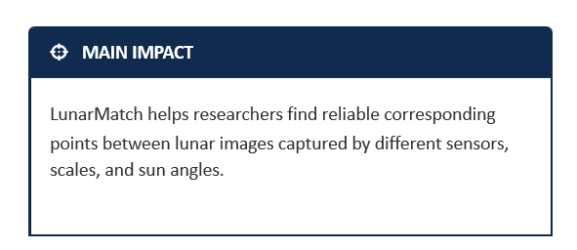


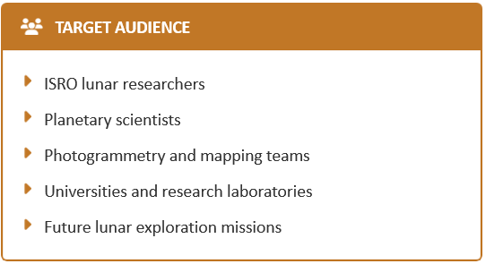



IMPACT AND BENEFITS
Shevolution
Mission impact
Makes it easier to find the same lunar location in images taken under different sunlight conditions.
→ Reduces manual effort when selecting matching points for lunar image registration.
Scientific value
Helps combine images from different instruments, such as Chandrayaan-2 and LRO.
→ More images can be compared and used together for lunar research.
Trust and governance
tChecks the detected matches before showing the final result.
→ Helps remove incorrect matches and gives researchers more confidence in the output.
Research ready outputs
Produces registered images, match points, metrics, GeoJSON/CSV, and PVL control-network files.
@SIH Idea submission- Template
5

Slide 6



RESEARCH AND REFERENCES
Shevolution
RESEARCH USED
  Illumination-Robust Matching: Research on orientation-based features helped us handle changes in lunar lighting.
  SIFT & LightGlue: Used as baseline and modern matching approaches for comparison.
  PDS Data Standards: Used to read Chandrayaan-2 and LRO image data.
  NAIF SPICE: Used to obtain accurate Sun/illumination geometry for LRO data.
  ISIS Control Network: Used as the output format for integration with the existing photogrammetry workflow.
WHAT WE ADDED
  Compared SIFT, Mod-π and LightGlue under different Sun-angle conditions.
  Added automatic scale alignment before matching.
  Added MAGSAC-based wrong-match removal.
  Added sub-pixel refinement and coverage checking.
  Added result-trust verification to flag unreliable registrations.
  Exported verified matches in ISIS-compatible format.
PROJECT RESOURCES
Repository:Repo LInk
Presentation deck (narrative version): Presentation Link
Test suite: 188 automated tests — tests/ directory
Datasets Used: https://data.lroc.im-ldi.com/lroc/search ,https://archive.org/details/chandrayaan-2-high-resolution-images-of-the-moon/OtherDownloads/CHACE-2/CHACE2_User_manual/
@SIH Idea submission- Template
6

